Slide 1
GEOG-G489/589 Advanced Geospatial Data Analysis in Python
Instructor: Natasha MacBean
Jupyter Notebook, Lists, Functions, Intro to NumPy

Slide 2
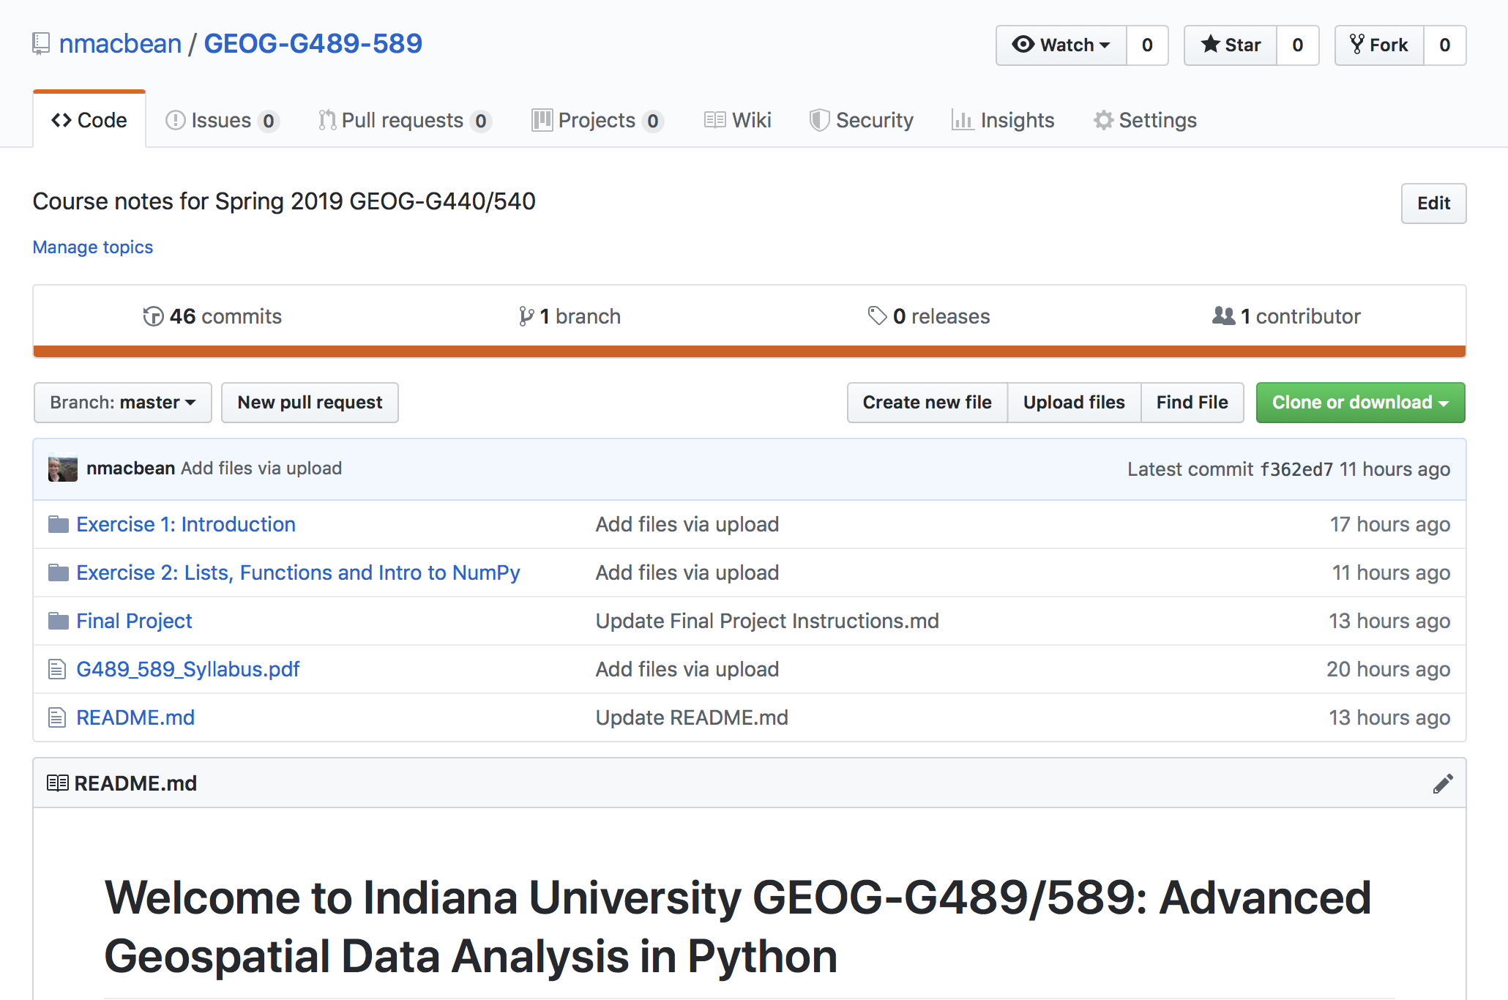
Course GitHub page
https://github.com/nmacbean/GEOG-G489-589
Any data files that we will use in each class will be in the relevant Exercise folder
The answers to the exercises will be pasted in the relevant folder on the GitHub Course Repository after the deadline.

Slide 3
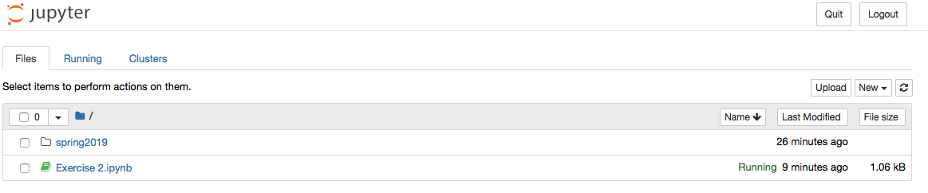
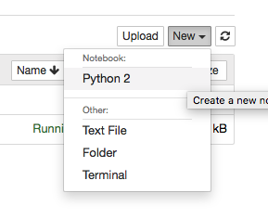
Intro to Jupyter Notebook
In today’s class we will load Jupyter Notebook using Git CMD on the STC computers
Search for Git Bash and open it up.
On the command line prompt, type "jupyter notebook" and the Jupyter Notebook server will load.

Slide 4
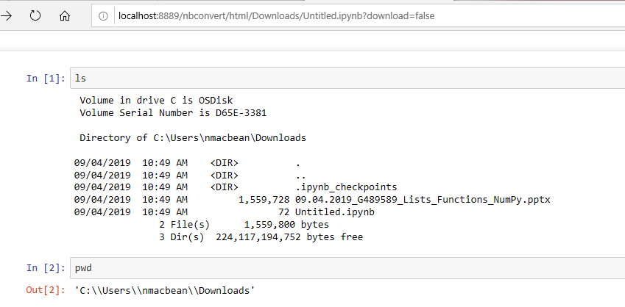
Intro to Jupyter Notebook
In today’s class we will load Jupyter Notebook using Git CMD on the STC computers
Search for “Git Bash” and open it up.
On the command line prompt, type "jupyter notebook" and the Jupyter Notebook server will load.

Slide 5
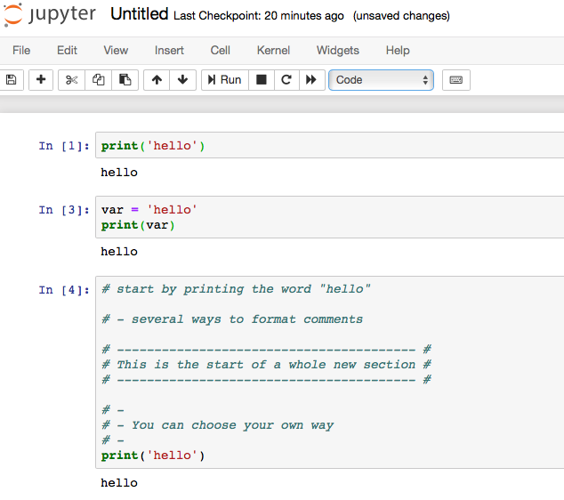
Intro to Jupyter Notebook
Running code (SHIFT + ENTER or press Run!)
Writing comments in your code

Slide 6
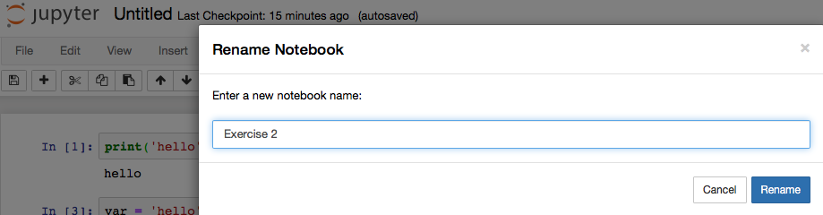
Intro to Jupyter Notebook
Changing filename

Slide 7
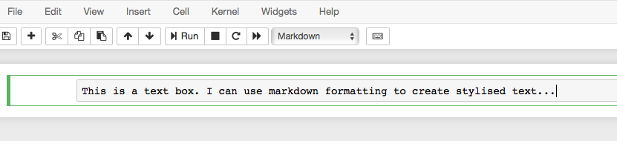
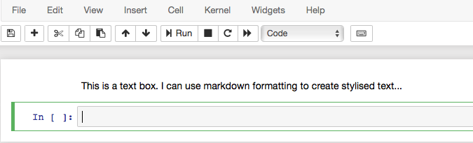
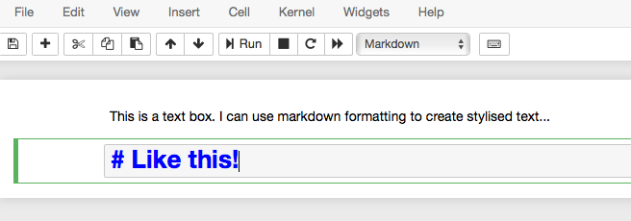
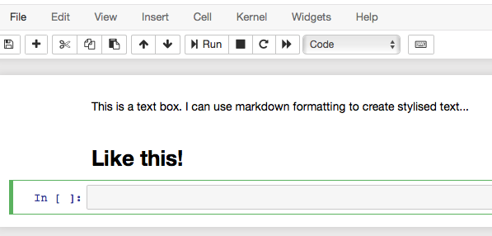
Intro to Jupyter Notebook
Writing text using markdown
https://jupyter-notebook.readthedocs.io/en/stable/examples/Notebook/Working%20With%20Markdown%20Cells.html

Slide 8
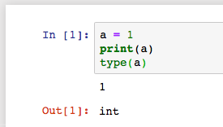
Brief note on variables and data types
What is a variable?
Int, float, str and bool quiz
Everything in Python is an object
Other object types we’ll learn over time (e.g. lists…)
Adding data types together

Slide 9
Simple functions in Python
Function is a piece of reusable code
Carries out a specific task
Returns something (e.g. completed task, or a value)
Useful standard functions: print(), type(), len(), round(), help(), max(), min()
Standard tasks probably already have a function in python → so Google away!

Slide 10
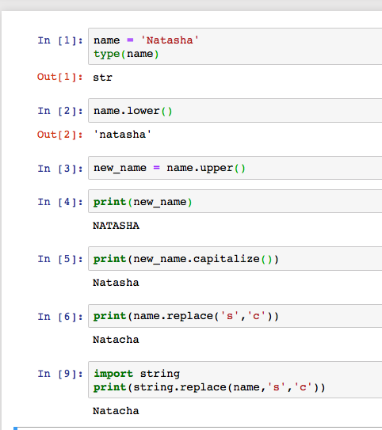
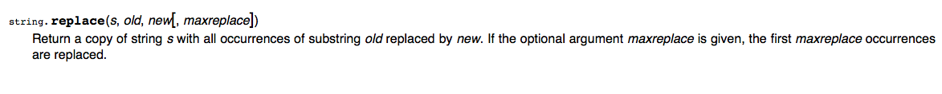
Methods: functions that belong to certain objects
Use “dot” notation
E.g. string methods: string.lower(), string.replace()
Objects of different types have different methods (see supplementary information in today’s assignment on GitHub for more details).
Google methods for different objects (e.g. Python string methods: https://docs.python.org/2/library/string.html)

Slide 11
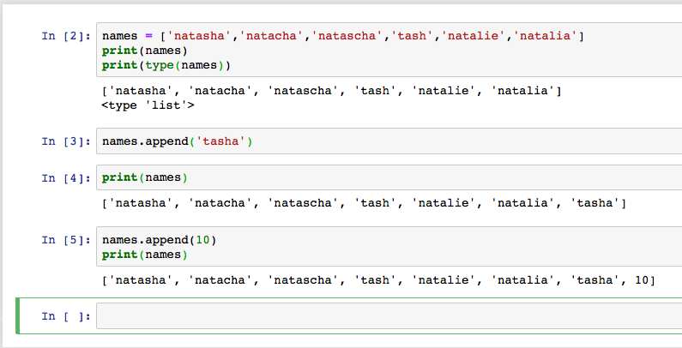
Lists and list methods
Some list methods: list.append(), list.count(), list.reverse()
See documentation for more methods: https://docs.python.org/3/tutorial/datastructures.html
Why are lists useful?
Notes:
Indexing:
-1, -2 etc
:6 etc
Slice for all :
Zero indexing

Slide 12
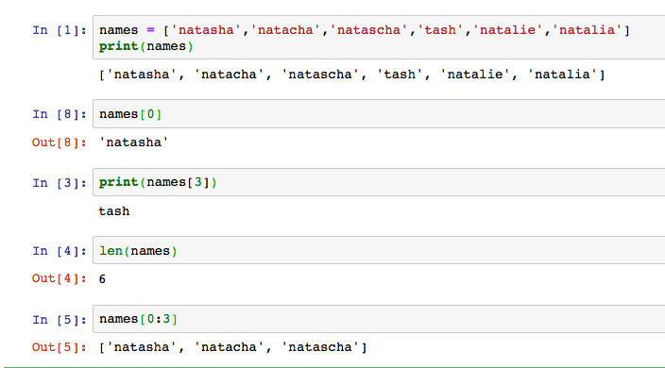
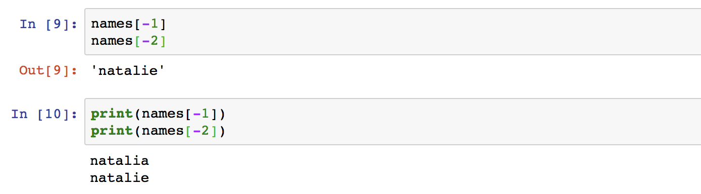
Lists, indexing, and subsetting
Want to select part of a list → indexing or slicing
Why might this be useful?
Notes:
Indexing:
-1, -2 etc
:6 etc
Slice for all :
Zero indexing

Slide 13
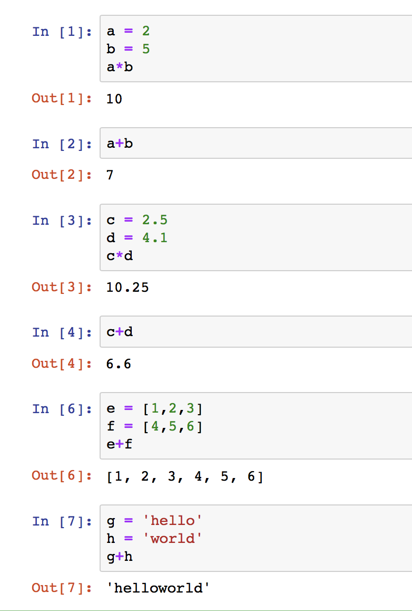
Adding data types together

Slide 14
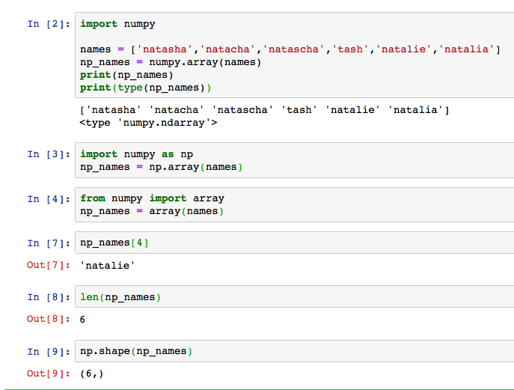
NumPy (Numerical Python) package
Useful for calculations over entire arrays of numerical data, e.g.: (1D and 2D)
Array: grid of values of same data type → best for numerical type of data → 1D, 2D, 3D…nD dimensions
Can only contain one type of data (unlike lists), but you can have arrays of strings
How do we load the numpy package? Using “import”
Indexing is similar……as are methods (e.g. np.shape())
Notes:
install numpy as np → a bit about python packages and need to install them as needed…
Collection of python scripts, with each script being a module of the package that performs specific functions/methods and has different objects/types
We’ll get to installing different packages on your own machine later…
Indexing and slicing the same as for lists…

Slide 15
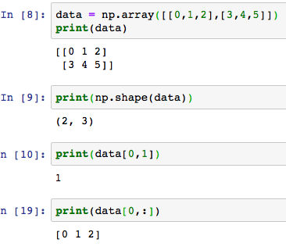
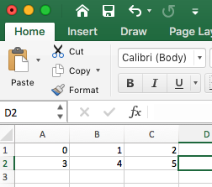
NumPy (Numerical Python) package
Really useful for 2 or more dimensions of numerical data
row
column
Notes:
install numpy as np → a bit about python packages and need to install them as needed…
Collection of python scripts, with each script being a module of the package that performs specific functions/methods and has different objects/types
We’ll get to installing different packages on your own machine later…
Indexing and slicing the same as for lists…

Slide 16
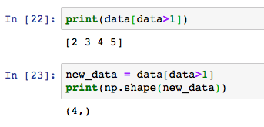
NumPy (Numerical Python) package
Can use logic to subset (data[data>X])
Notes:
install numpy as np → a bit about python packages and need to install them as needed…
Collection of python scripts, with each script being a module of the package that performs specific functions/methods and has different objects/types
We’ll get to installing different packages on your own machine later…
Indexing and slicing the same as for lists…

Slide 17
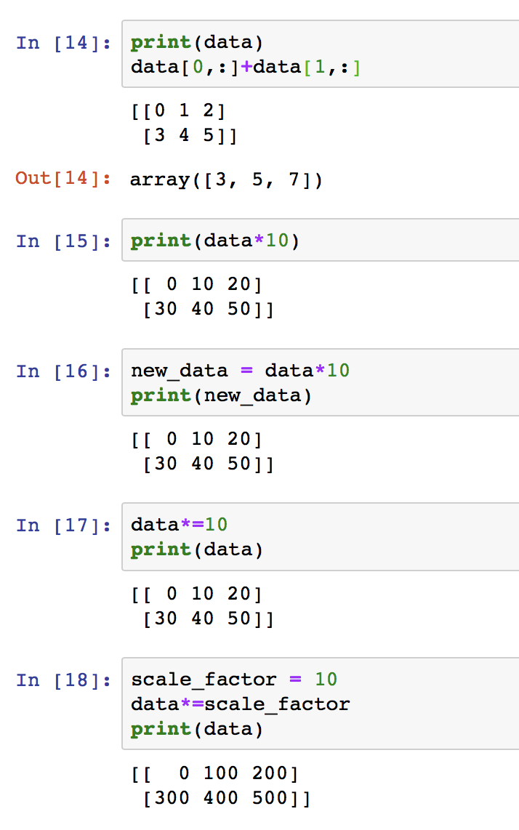
NumPy (Numerical Python) package
Array arithmetic…
Notes:
install numpy as np → a bit about python packages and need to install them as needed…
Collection of python scripts, with each script being a module of the package that performs specific functions/methods and has different objects/types
We’ll get to installing different packages on your own machine later…
Indexing and slicing the same as for lists…

Slide 18
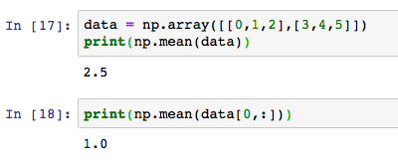
NumPy (Numerical Python) package
np.mean and other basic functions np.sum(), np.sort(), np.std(), np.round()
Notes:
install numpy as np → a bit about python packages and need to install them as needed…
Collection of python scripts, with each script being a module of the package that performs specific functions/methods and has different objects/types
We’ll get to installing different packages on your own machine later…
Indexing and slicing the same as for lists…

Slide 19
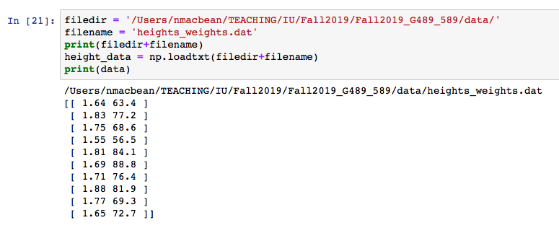
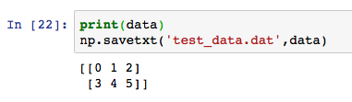
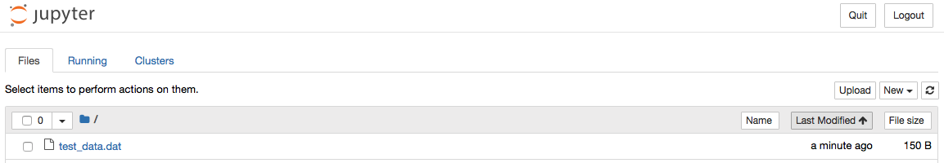
NumPy (Numerical Python) package
Loading and saving data files → np.loadtxt(), np.savetxt()
https://docs.scipy.org/doc/numpy/reference/generated/numpy.savetxt.html
Notes:
install numpy as np → a bit about python packages and need to install them as needed…
Collection of python scripts, with each script being a module of the package that performs specific functions/methods and has different objects/types
We’ll get to installing different packages on your own machine later…
Indexing and slicing the same as for lists…

Slide 20
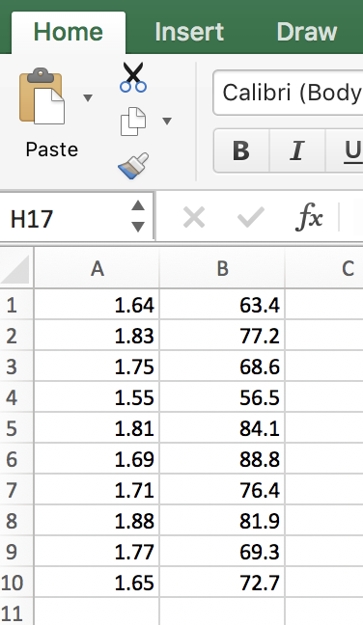
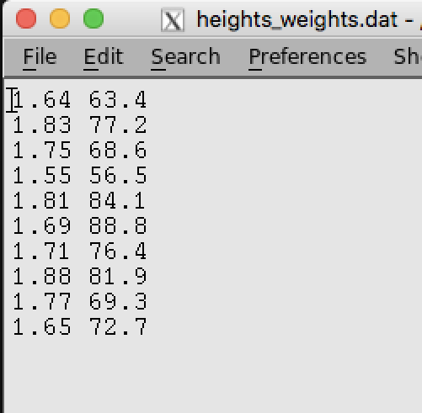
Today’s exercise
We have a file containing height and weight information for 10 people.

Slide 21
Today’s exercise
We have a file containing height and weight information for 10 people.
We want to perform the following tasks:
load the data into a variable called "data" in your jupyter notebook
calculate mean height and mean weight for all 10 people (and print answer)
get the height and weight information for the 4th person
save the size information for the 4th person in a new file with a new name
Extra task if you are not new to python: sort the whole array based on height (and print answer)

Slide 22
Getting started with the exercise
Go back to the GitHub course repository
Find the folder for Exercise 2 and download the ’heights_weights.dat’ data file into your Downloads folder
The directory (filepath) for this file should now be: C:\Users\your_username\Downloads\. In a python string, we need to add extra ‘\’ before… “C:\\Users\\your_username\\Downloads\\”
Open a new jupyter notebook and give it a title of your name and then Exercise 2, e.g. nmacbean_exercise2
Complete this exercise in a Jupyter Notebook with the title "Your_Name Exercise 2". Upload the jupyter notebook to Canvas by the beginning of next class - Monday 9th September at 1pm.
Good luck and feel free to ask me any questions or to work with others!

